Slide 1
Level Set Methods
Baris Sumengen
Vision Research Lab
UCSB

Slide 2
Problem Definition
In 2-D, Curve (Interface) evolution over time.
In 3-D, Surface (Interface) evolution.
  Example: Waves in the ocean.
  Waves can be uniquely modeled if we track the boundary between air and water (the interface).

Slide 3
How to Model and Implement
Model the physical process and interface motion using partial derivative equations (PDE).
Level Set Methods are used for the implementation of curve/interface evolution under various forces.
Challenges:
  Numerical errors due to discretization.
  Estimation of derivatives around discontinuities.
  Numerical stability of the implementation.

Slide 4
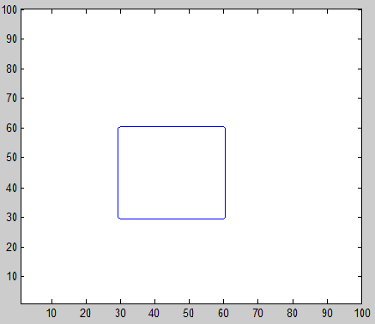
Curve representation
A closed curve cannot be represented as a 1-D function y = f(x)
A parametric representation can be used:
  C = {x(p), y(p)}
  p is in [0,1]
C

Slide 5
Curve Representation
Explicit (parametric) representation
  Uses a parametric representation
  Sample the curve at fixed intervals.
  Problem: During evolution, curve changes, so does the parameterization.
Implicit representation (Level set methods)
  Embed the curve C into a 2-D function
  z = f(x,y)

Slide 6
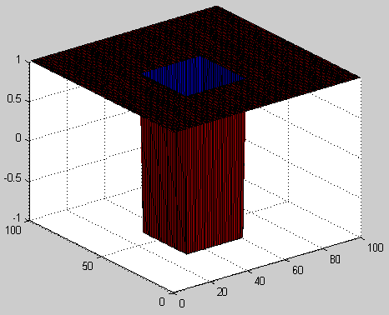
Implicit Methods
Curve is embedded as the 0 level set.
C = {(x,y) | f(x,y) = 0}
f(x,y)
C

Slide 7
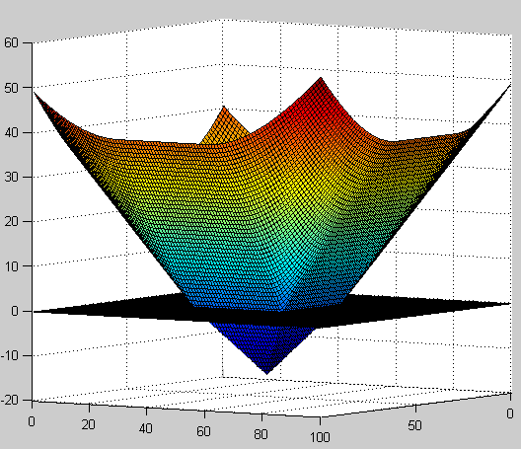
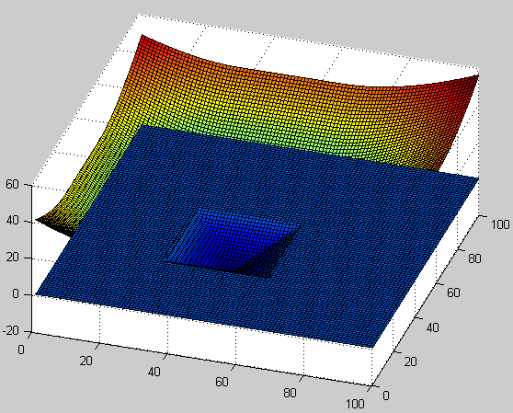
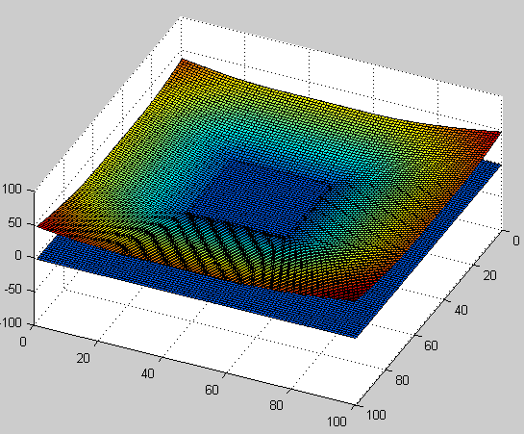
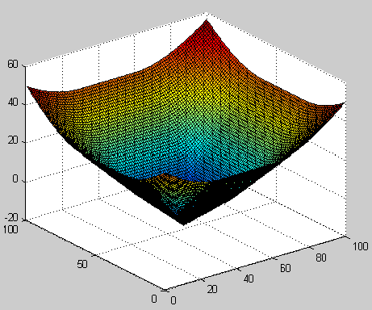
Implicit Methods
A better embedding function is smoother
C

Slide 8
Level Set Methods
Main idea:
  Evolve the embedding function f(x,y)
  Keep track of its zero level set
This can thought as the diffusion of a 2-D surface.

Slide 9
Embedding Function Design
Given a curve,
Design f(x,y)
  Signed distance function.
+
C
(x,y)
.
-
d
Sign of f(x,y)
Value of f(x,y)

Slide 10
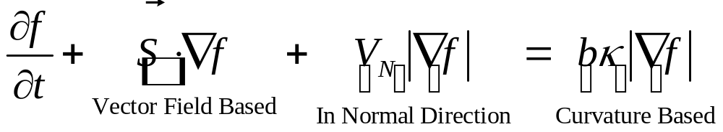
Evolution Forces
Types of forces
  A force in the normal direction to the curve
  An external vector field
  A force based on the curvature of the curve.
Partial Differential Equation:

Slide 11
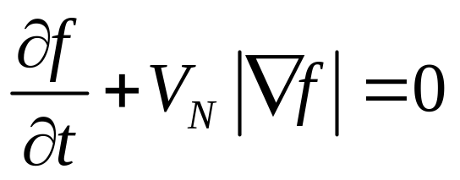
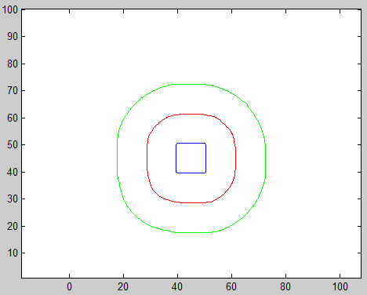
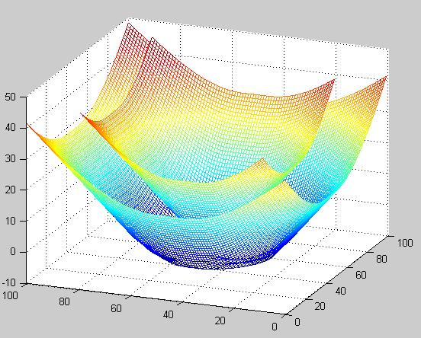
Force in Normal Direction
All level sets of f(x,y) are evolving.
We only track zero level set.
V_{n} = 1

Slide 12
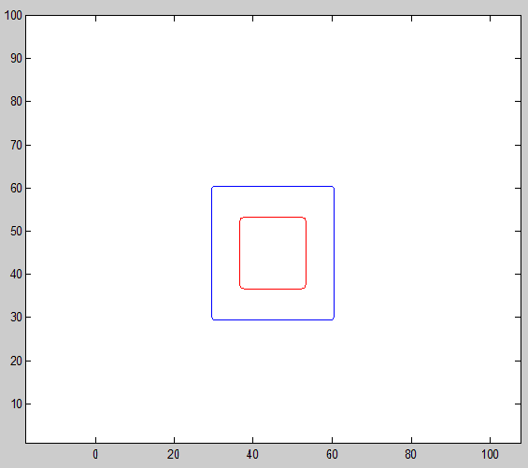

Shrink in Normal Direction
V_{n} = -1
Shrinks the curve

Slide 13
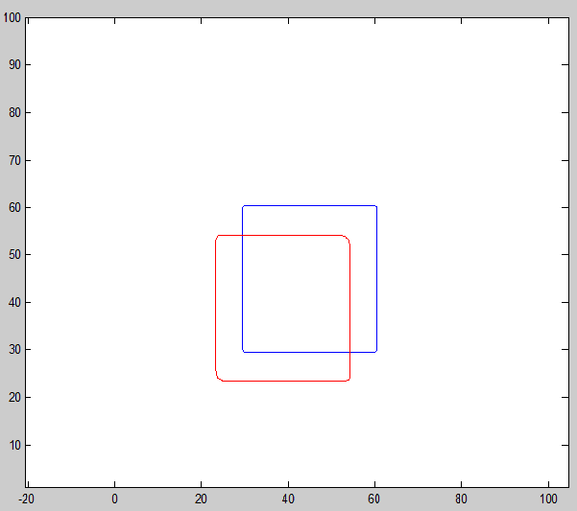
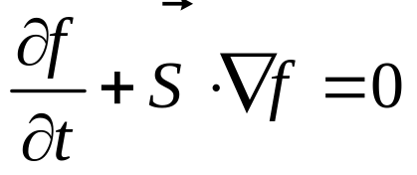
External Vector Field

Slide 14
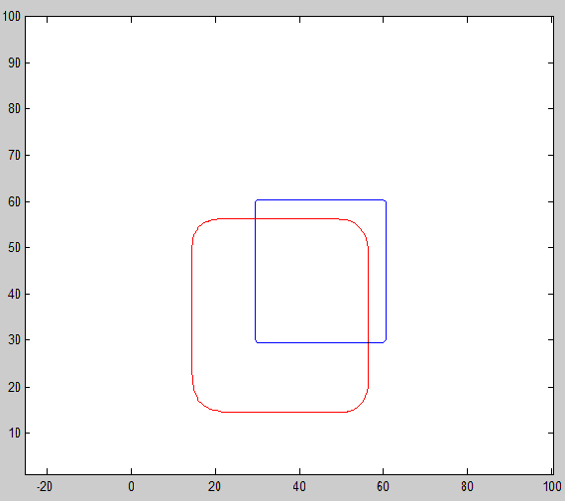
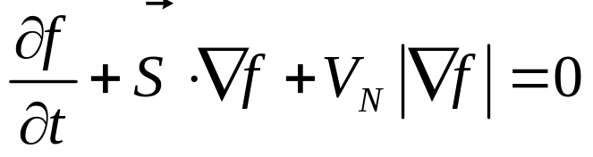
Simultanous Translation and Expansion

Slide 15
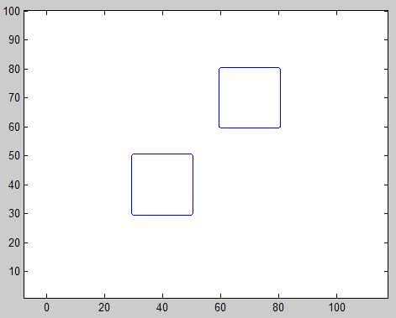
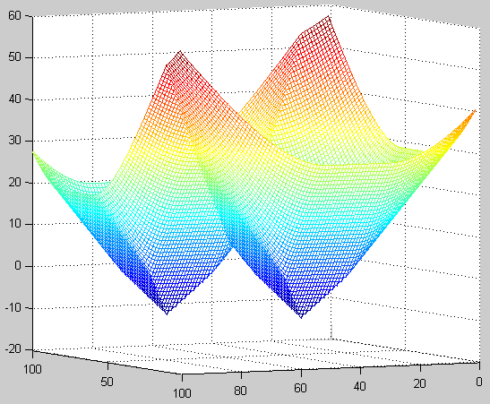
Multi-part Curves

Slide 16
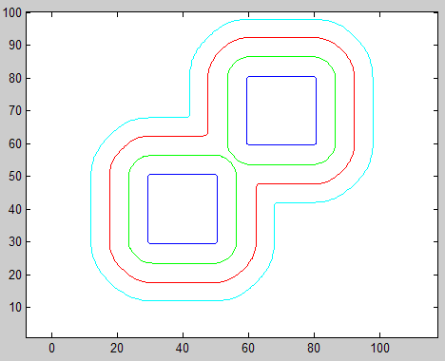
Merging of curves
Topological changes such as merging and splitting are taken care of by Level Set Methods

Slide 17
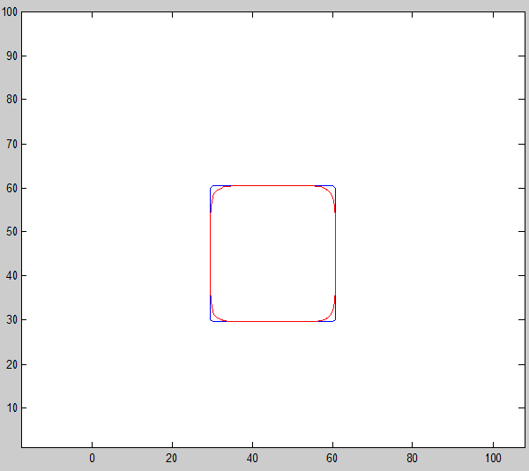
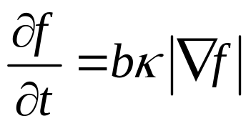
Curvature-based force
Curvature of a straight line is 0
Only corners are smoothed.

Slide 18
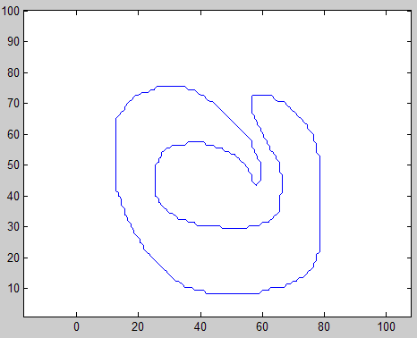
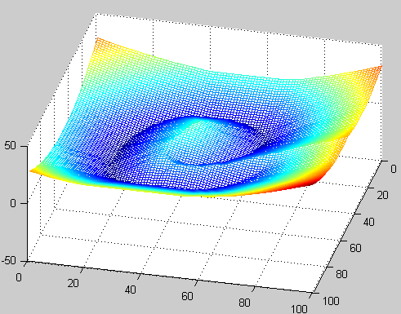
Curvature-based force
f(x,y)

Slide 19
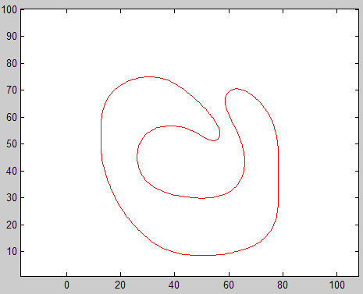
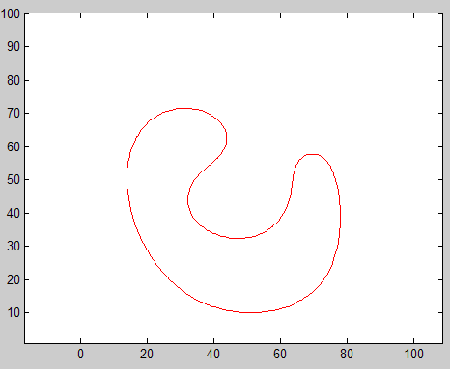
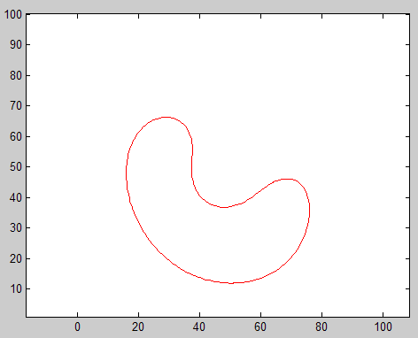
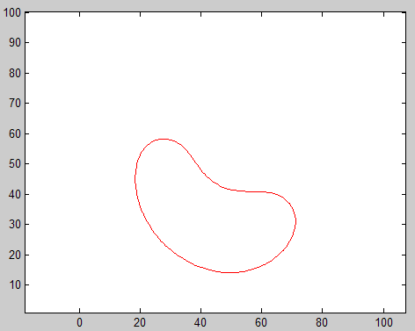
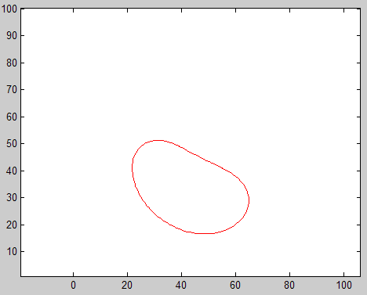
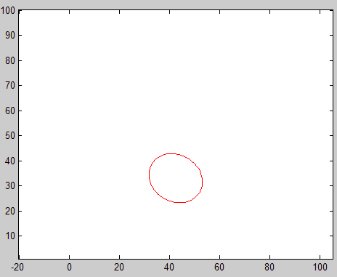
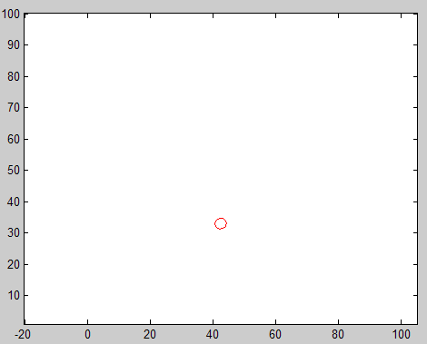
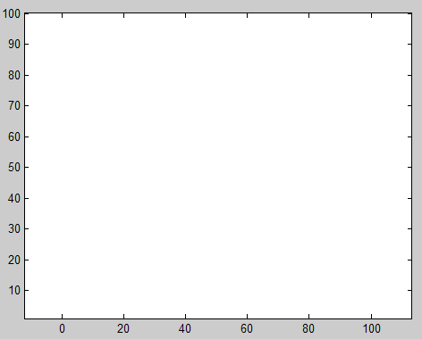
Curvature-based force

Slide 20
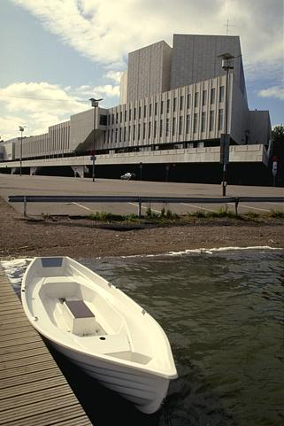
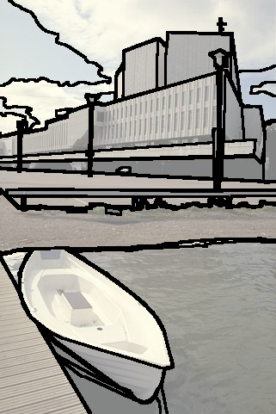
Image Segmentation

Slide 21
Image Segmentation
Design a PDE that uses:
  An edge function: Stops the curve around edges.
  Vector field: Pulls the curve towards the edges.

Slide 22


Edgeflow Vector Field
Ma and Manjunath (CVPR 1997)
Edge
Notes:
Example of the vector field with a binary image.
Then show the Gaussian offset of 4sigma and discuss why this doesn’t work well for us.

Slide 23
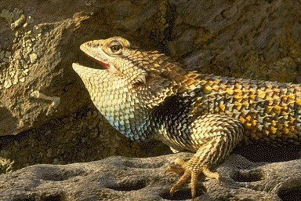
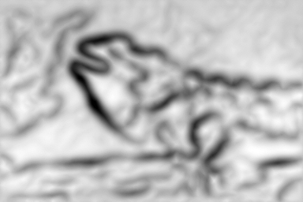

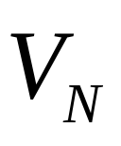

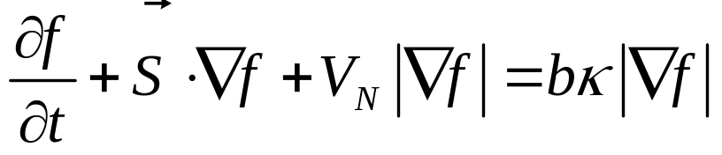

Image Segmentation
Edge function

Slide 24
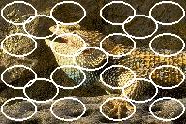
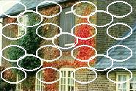
Image Segmentation
Initialize many independent curves
Evolve them separately.
Superimpose the results.
Videos

Slide 25
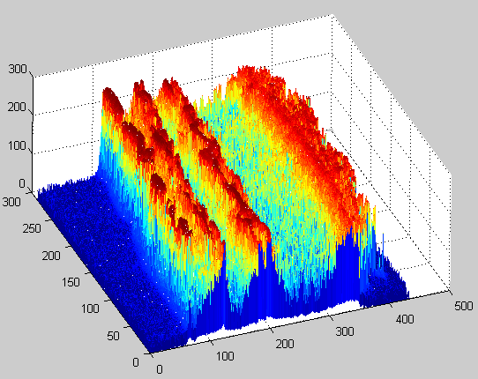
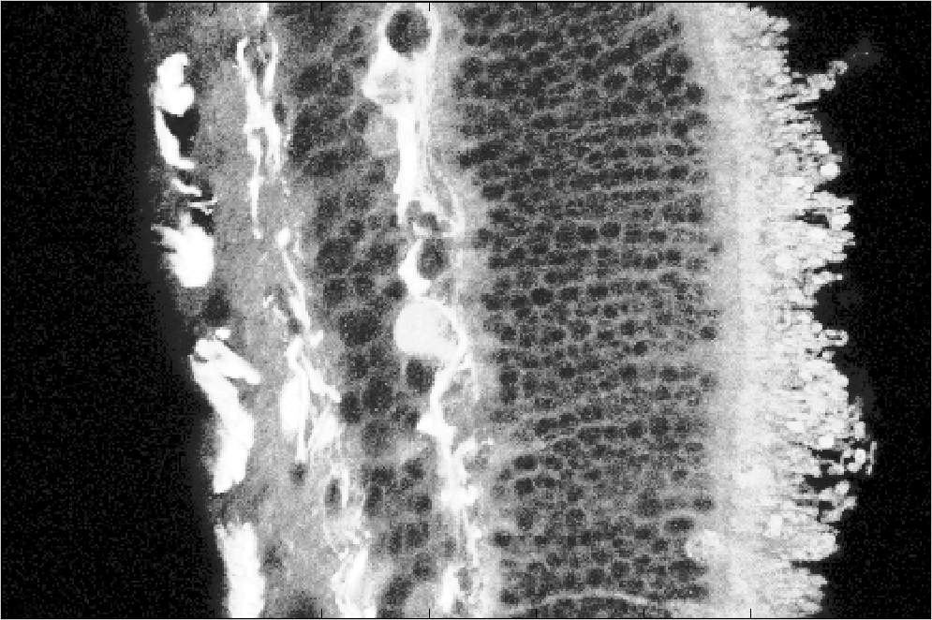
Curvature Diffusion
Image itself is taken as f(x,y)
f(x,y)
Retina Cross Section

Slide 26
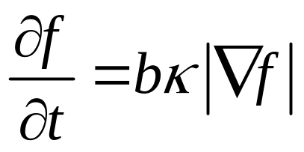
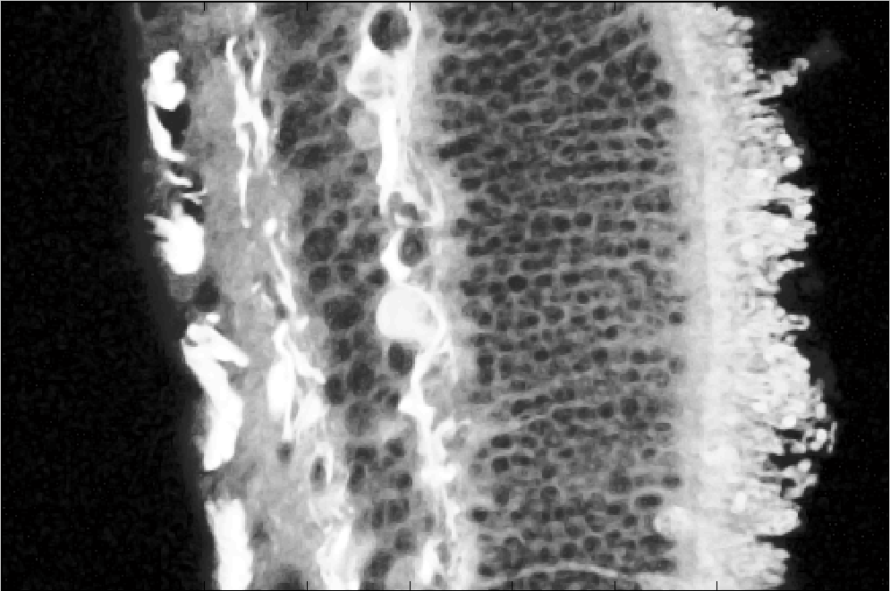
Curvature Diffusion
Curvature-based
Level Set evolution
Each level set of the image is evolved.
Used for noise removal.

Slide 27
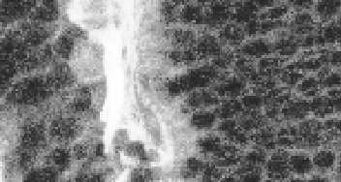
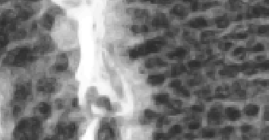
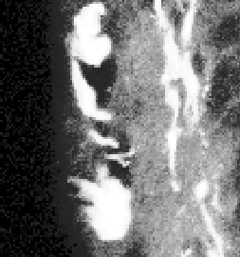
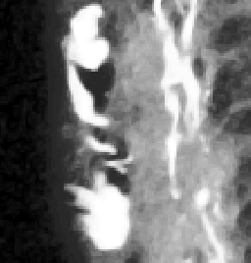
Curvature Diffusion

Slide 28
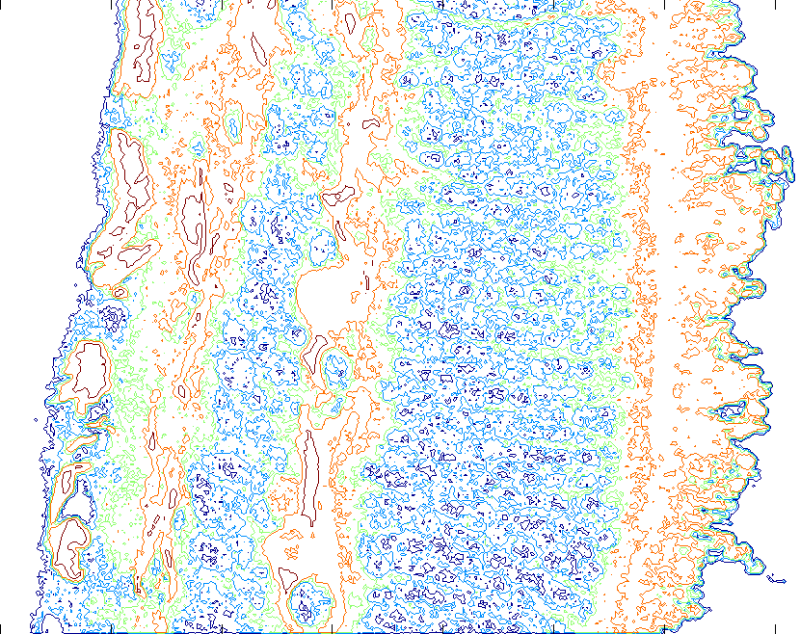
Level Sets

Slide 29
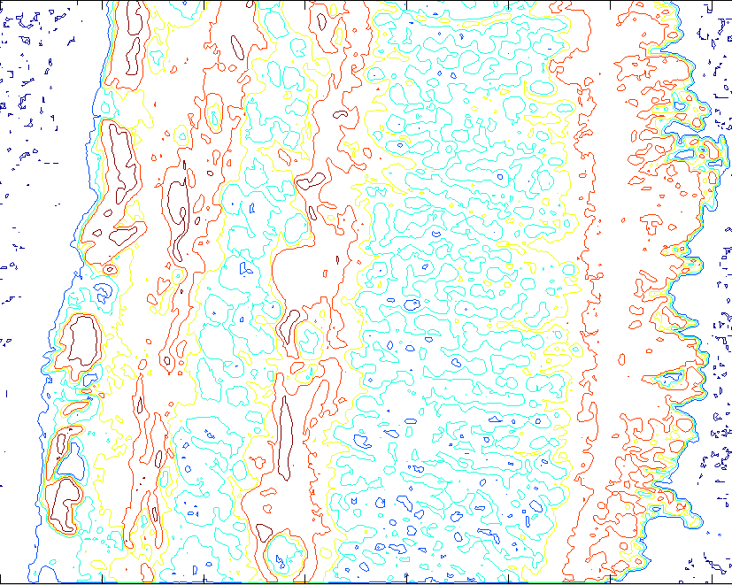
Level Sets after 5 iteration

Slide 30
Anisotropic Diffusion
Diffuse image such that
  Flat areas are smoothed.
  Edges are preserved and sharpened.
Again, take the image I(x,y) as the level set function f(x,y)

Slide 31
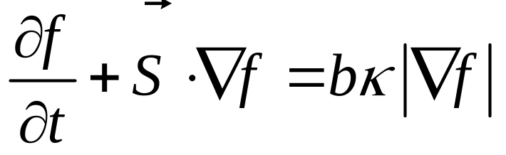
Anisotropic Diffusion
Use two forces:
  Vector Field (Edgeflow Vector field)
  Curvature (b is edge function)
Vector Field sharpens the image around edges
Curvature smoothes the image everywhere except around edges.

Slide 32
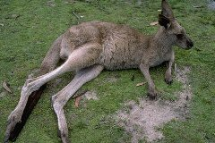


Anisotropic Diffusion
Color images has three planes: R, G, B
Convert RGB space to L*a*b* color space
Apply diffusion to L*, a*, and b* separately
Videos

Slide 33
Conclusion
Level Set methods are used for implementing curve evolution or diffusion.
Level Set Methods can also be used for surface evolution
  Applications in Computer Graphics.
  Volume segmentation in 3-D images.
Matlab toolbox for trying these examples can be downloaded from:
  http://vision.ece.ucsb.edu/download.html

Slide 34
Thanks!

